Slide 1

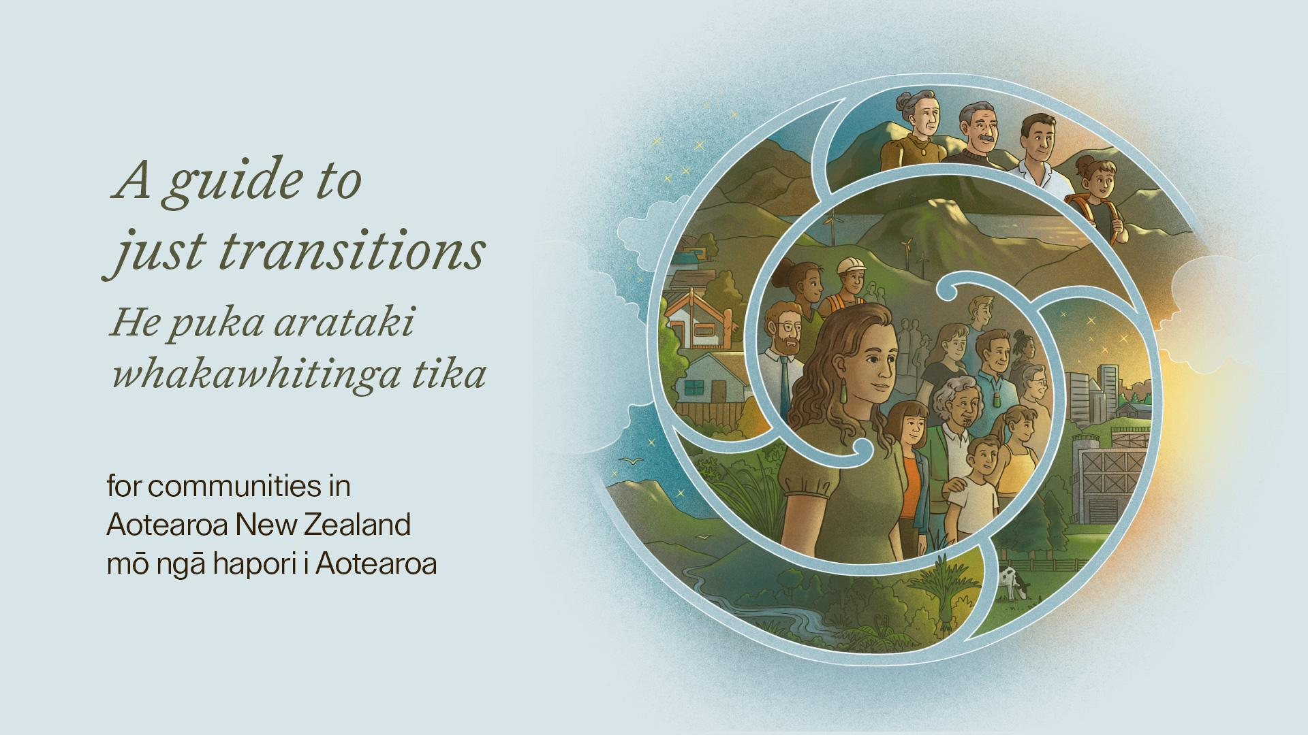
Motu Public Policy Seminar
7 August 2023

Slide 2
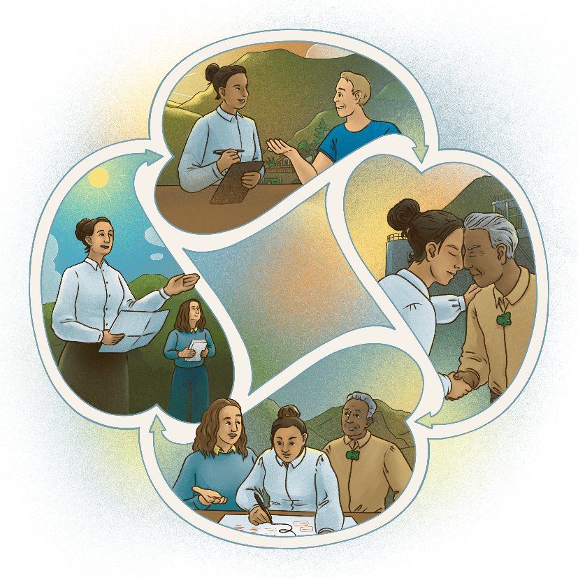
Outline
Why was the guide created?
How was the guide developed?
What are just transitions?
What are just transition processes?
Discussion
Conclusion
Where can you find the guide?

Slide 3
1. Why was the guide created?
Plan for and manage change
Environmental and social challenges
Communities often know best
Practical tools for communities to lead
Notes:
Across Aotearoa New Zealand, communities are confronting major environmental and social challenges, like changes to the climate, technologies, employment, energy systems and land use.
Our communities have a deep understanding of what is happening, how it is impacting on people and what solutions will work.
The guide provides practical tools for communities to lead processes of change towards outcomes that support just outcomes and wellbeing for all.
This does not mean communities must act alone; government has an important enabling role.

Slide 4
2. How was the guide developed?
Commissioned by the Ministry of Business, Innovation and Employment
Co-funding from the Aotearoa Foundation
Team of authors, advisors, facilitators and designers led by Motu Economic and Public Policy Research
Inclusive approach – user-needs survey, dialogue meetings and external peer review
Notes:
Commissioned by the Just Transition Partnership team at the Ministry of Business, Innovation and Employment
Supported by co-funding from the Aotearoa Foundation for broader research and engagement
Written by the Just Transitions Aotearoa Group, a team of over 25 authors, advisors, facilitators and designers led by Motu Economic and Public Policy Research
Used an inclusive approach with a user needs survey, five dialogue meetings with community practitioners and external peer review

Slide 5
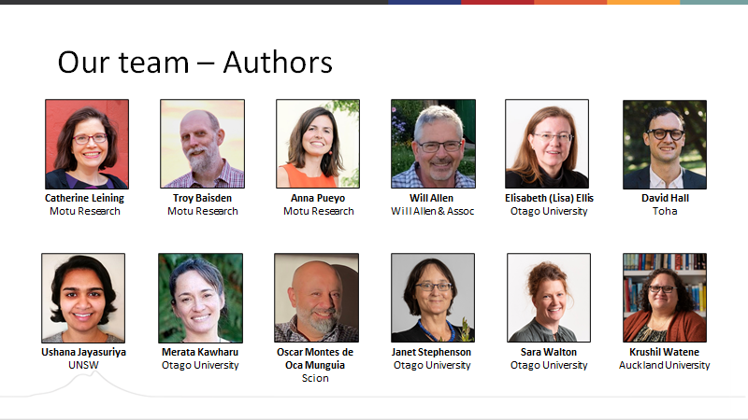

Slide 6
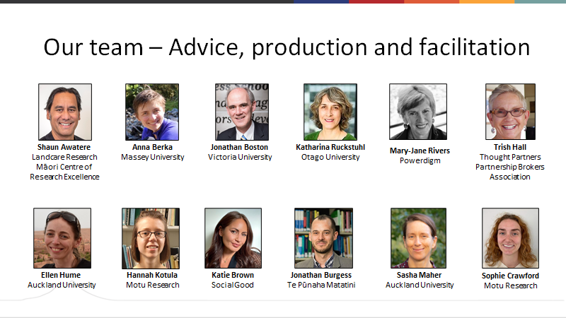

Slide 7
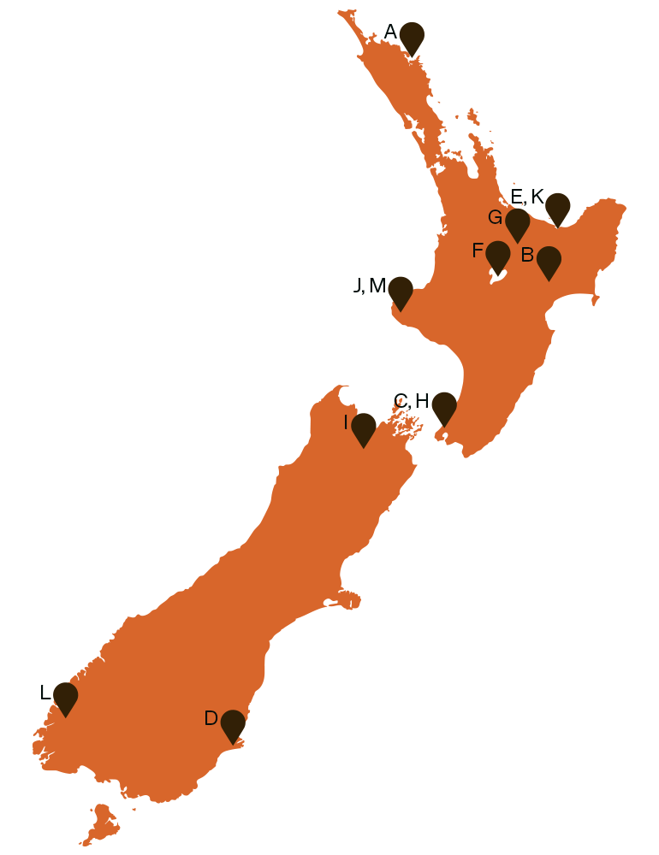
2.1 What are the case studies?
The 17 case studies show just transition principles and processes in action – even if they might not be named as such by participants.
The case studies may be work-in-progress or the outcomes may have fallen short of aspirations, but there is value from the process.
Notes:
The 17 case studies show just transition principles and processes in action in Aotearoa New Zealand – even if they might not be named as such by participants.
Even when their outcomes are still in progress or fall short of aspirations, community-led just transition processes can have huge value from the experiences gained and the relationships strengthened.

Slide 8

3. What are just transitions?
Change can be fast/slow, global/local, planned/unplanned
Opportunity for positive outcomes
No single definition – depends on the context
Notes:
Transitions mean fundamental changes to systems. They can be fast or slow, global or local, planned or unplanned.
Just transitions bring people together to transform disruptive change into positive change.
The concept emerged decades ago from North American unions concerned about job losses in polluting industries, but now is applied more broadly.
Today, there is no single definition of just transitions; each group can decide what is needed in its context.

Slide 9
3.1 International examples
“A just transition means greening the economy in a way that is as fair and inclusive as possible to everyone concerned, creating decent work opportunities and leaving no one behind.”
- International Labour Organisation
“Just transition is a vision-led, unifying and place-based set of principles, processes and practices that build economic and political power to shift from an extractive economy to a regenerative economy.”
- Climate Justice Alliance (USA)
“The imperative of a just transition is that governments design policies in a way that ensures the benefits of climate change action are shared widely, while the costs do not unfairly burden those least able to pay, or whose livelihoods are directly or indirectly at risk as the economy shifts and changes.”
- Just Transition Commission (Scotland)
“At the company level, a just transition is an enterprise-wide process that plans emissions reduction efforts to maximize positive impacts and minimize negative impacts on workers and communities through retention and redeployment, skills training, new job creation, social inclusion and community renewal.”
- Just Transitions Centre and the B Team
Notes:
No single definition:
International Labour Organisation – greening economy, fair and inclusive, decent work, no one left behind
Climate Justice Alliance – vision-led, unifying, place-based, shift to a regerative economy
Just Transition Commission – benefits widely shared, costs do not fall on those most vulnerable
Just Transition Centre and the B team – maximise positive impacts and minimise positive impacts on workers and communities – training, job creating, social inclusion and community renewal

Slide 10
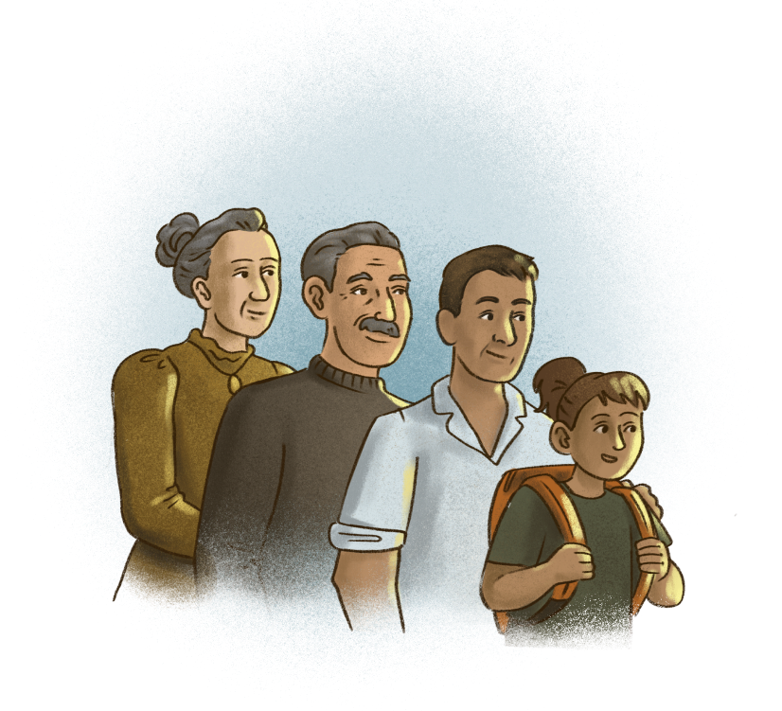
3.2 Features of just transitions in the guide
Restore and rejuvenate mauri life force
Bring systems and supports into balance
Address injustices
Inclusive - shared principles and visions
Support oranga wellbeing for all
Notes:
Restore and rejuvenate mauri life force to bring social, economic and environmental systems and supports into balance
Address injustices
Are inclusive and based on shared principles, values and visions
Support oranga wellbeing for all

Slide 11
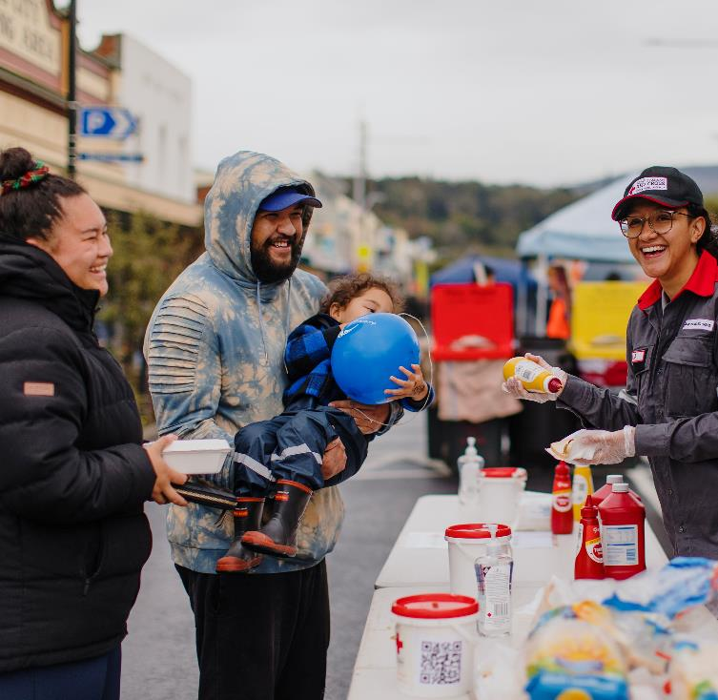
3.3 Caring through a community network in South Dunedin
For the South Dunedin Community Network, care means ensuring as many people as possible are involved in the learning and decision-making essential to manage the changes inevitably coming to their landscape.
The network has instituted twice yearly community hui, where the decision-makers share what they are doing and listen to community members.

Slide 12
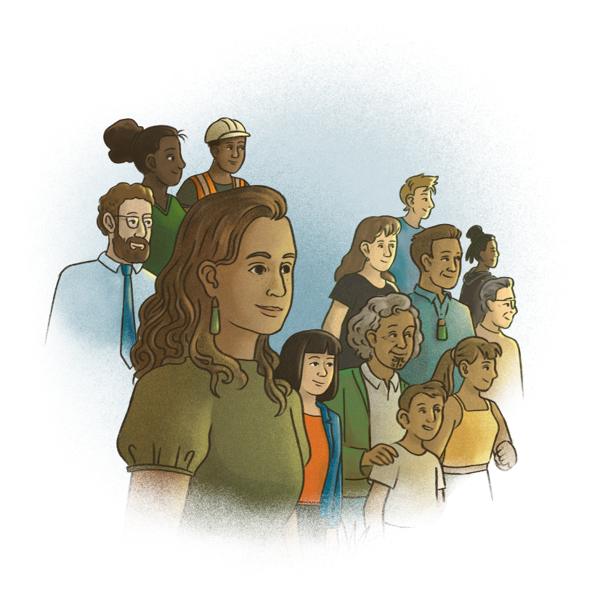
3.4 Just transitions and Te Tiriti
Fundamental framework – Te Tiriti o Waitangi
Process recognises past and ongoing injustices and inequities for Māori
Iwi and hapū resourced and empowered to lead and/or participate
Notes:
In Aotearoa New Zealand, there is a national framework that applies in a just transition process: Te Tiriti o Waitangi.
Just transitions should recognise the past and ongoing injustices and inequities for Māori.
To give effect to Te Tiriti, a just transition process must be resourced and empowered through regulatory and legal frameworks.

Slide 13

3.5 Just transitions and te ao Māori
Te ao Māori the Māori worldview helps to shape processes and address complex problems
Māori concepts and values have provided a framework for change for generations
Tikanga and mātauranga
Examples of transitions led by iwi, hapū and Māori communities
Notes:
Te ao Māori can help shape just transition processes to better address complex problems.
Māori concepts and values have guided responsiveness to and planning for change for generations.
The guide draws on tikanga and mātauranga and includes case studies of transitions led by iwi, hapū and Māori communities as well as others.

Slide 14
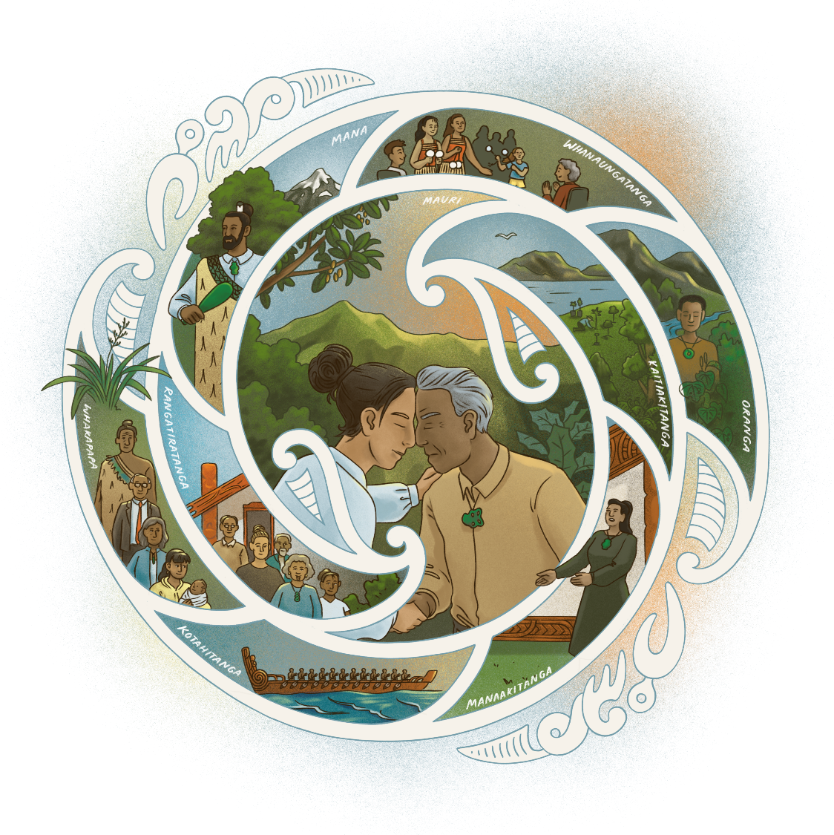
3.6 Mātāpono principles
Mātāpono principles shape how we work together
Mātāpono principles applied by communities in the local context
Application always informed by tikanga
Notes:
The guide highlights mātāpono that may guide processes for working together.
Their application should be defined by communities themselves (as informed by tikanga).

Slide 15
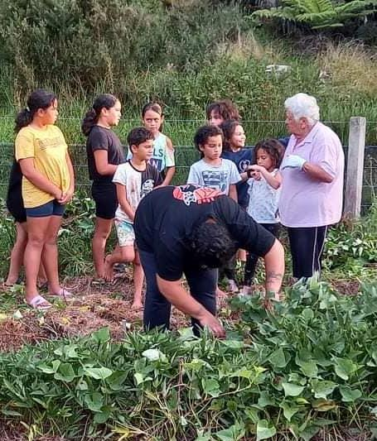
3.7 Ngāti Manu keep the home fires burning
Ngāti Manu have accelerated their social and ecological plans for the Kāretu Valley in the Bay of Islands by establishing a māra kai community garden, a native tree nursery and a marae-based education programme, Nga Kaitiaki o te Ahi.
They have, in a short space of time, built resilience, responsiveness and innovation in the face of radical social and environmental change.

Slide 16

4. What are just transition processes?
Communities working together
Collective action
Shared visions and values
Equitable outcomes
Stages of a just transition:
Connecting
Planning
Acting
Adapting
Notes:
Just transition processes bring communities together to take collective action shaped by shared visions and values supporting equitable outcomes.
The guide covers four stages:
Connecting
Planning
Acting
Adapting

Slide 17
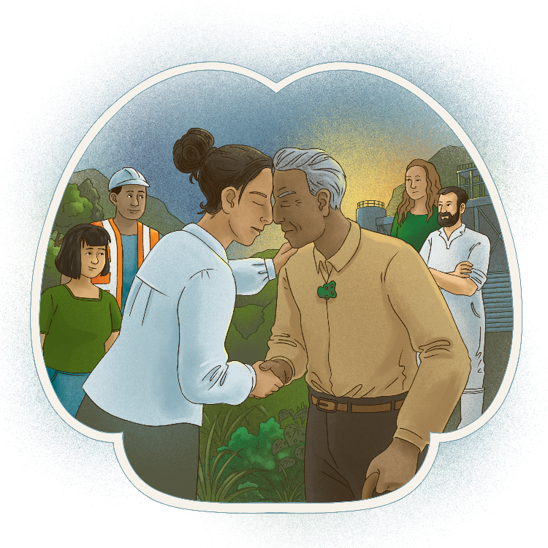
4.1 Connecting
Te tūhonohono
Building relationships
Developing a leadership group
Facilitating
Care and support

Slide 18
4.2 Connecting – Key messages
Trust and shared understanding
Community leadership
Facilitation - inclusive, supportive, cooperative and effective processes
Seek to understand
Build support and momentum
Notes:
Collective action requires strong relationships based on trust and shared understanding.
All over Aotearoa New Zealand people are stepping up to lead or help lead a transition in their community.
Facilitation is about supporting groups to work cooperatively and effectively together and involving all participants in a meaningful way.
Seeking to understand and meet the concerns and needs of those involved will help build enduring support for constructive action.
Building support requires engaging the persuadables while supporting the willing.

Slide 19
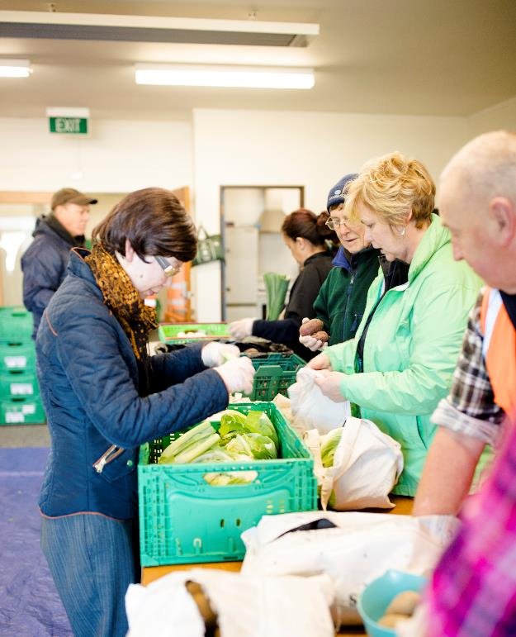
4.3 Te Hiko: Centre for Community Innovation
After working closely alongside whānau families and hapori communities in Porirua, the Hutt Valley and Wellington, Wesley Community Action have learned that with the right support, the hapori with first-hand experience can drive sustainable responses to complex issues.
Rather than a single transition process, this is about multiple initiatives and projects driven by members of the community, joined up and learning from each other over time.

Slide 20
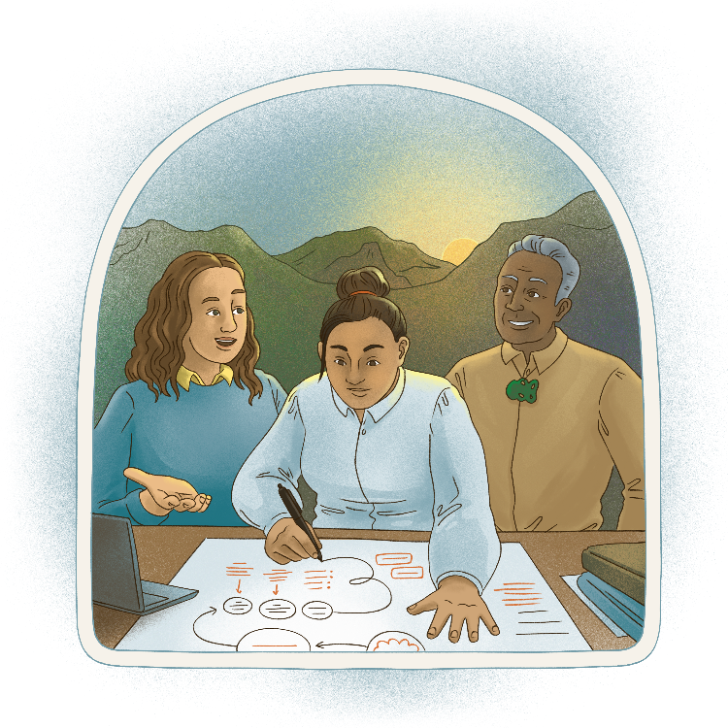
4.4 Planning
Te whakamahere
Designing processes
Understanding the system
Shared vision and values
Communication
Notes:
Designing transition processes
Understanding the system
Developing a shared vision and values
Communicating with others

Slide 21
4.5 Planning – Key messages
Structured to reflect context
Systems thinking - linkages and interactions
Working together to identify shared vision and values
Communication and connection
Notes:
How people organise their work together can be structured in different ways, reflecting the diverse contexts in which transitions arise.
Systems thinking makes sense of the complexity of the world by looking at the linkages and interactions between parts, rather than by studying parts individually.
Working together to identify a shared vision and values can help a diverse group choose a common direction.
From the start of your transition process, you need to think about how you will communicate about it with people both inside and outside the process – especially those that will be affected by it.

Slide 22
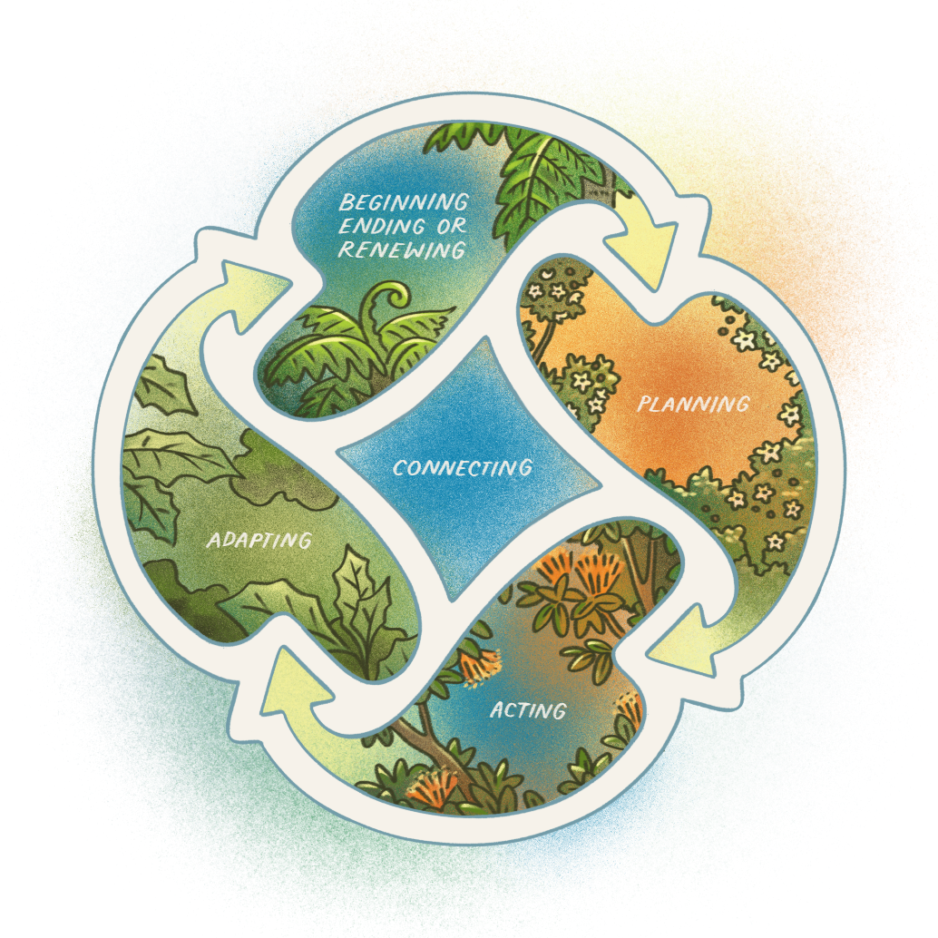
4.6 Planning – a decision-making cycle
Notes:
Here is a basic decision-making cycle that could be adapted for a just transition process. While the steps are presented in sequence, the process of decision-making is not likely to be linear or predictable. At times it may be necessary to go backwards to move forward.

Slide 23

4.7 Transforming Lake Taupō
In 2001 Waikato Regional Council began a process to protect the water quality in Lake Taupō from increasing concentrations of nitrogen.
The resulting cap-and-trade system reflected the focus on inclusiveness, transparency and fairness.
Successes included government funding, halting the water quality decline of the lake and maintaining sport fisheries and tourism. New brands captured value generated from the narrative of saving a large lake.

Slide 24
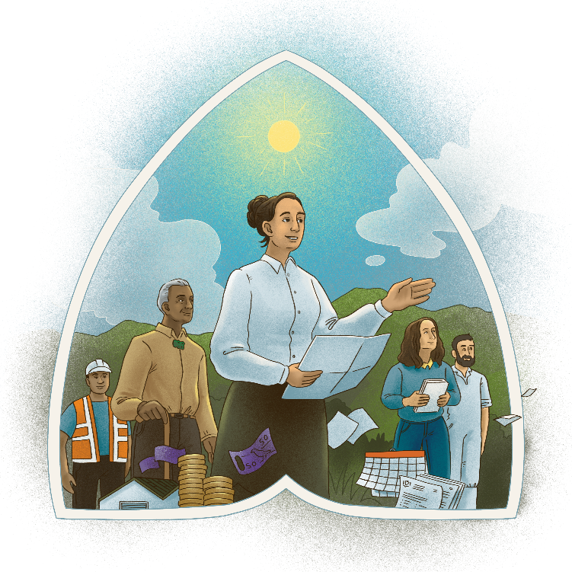
4.8 Acting
Te whakatinana
Decision-making
Generating options
Designing
Implementing
Resourcing
Notes:
Making collective decisions
Considering options
Designing and implementing solutions
Resourcing change processes

Slide 25
4.9 Acting – Key messages
Authority to make decisions
Options analysis
Feasibility assessment
Strategies and action plans
Funding and other resources
Notes:
The outcomes achieved by your transition will depend on having the authority to make decisions with impact.
Collective understanding of options supports better decision-making.
Strategies and action plans are vital for collective action to deliver results.
Funding and other resources are important for making new things happen, and sustaining and extending what is already happening.

Slide 26
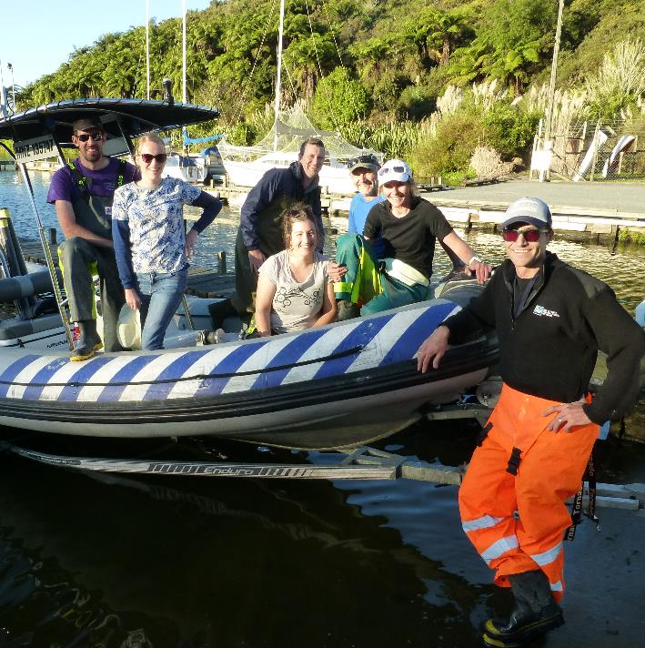
4.10 The Land and Water Forum
The LAWF applied consensus-based collaborative governance to develop an overall package of reforms for managing freshwater.
The major achievement was improving stakeholder relationships to achieve significant progress in policy direction. Despite the initial progress, many recommendations were not fully implemented and the forum lost credibility.

Slide 27

4.11 Adapting
Te urutau
Agile and adaptive
Monitoring
Evaluating
Improving, ending, renewing
Notes:
Being agile and adaptive
Monitoring your progress
Evaluating and improving
Ending or renewing your transition

Slide 28
4.12 Adapting – Key messages
Adaptive approaches to navigate uncertainty
Stay true to values
Continual improvement
Monitoring and evaluating
Identify when to end
Notes:
Adaptive approaches allow communities to navigate through uncertainty while staying true to their values.
Monitoring is about collecting information to assess progress.
Evaluating the impacts of a just transition process or activity enables continual improvement.
Every just transition process will come to its own point of transition, either to evolve to a new stage of work or to close

Slide 29
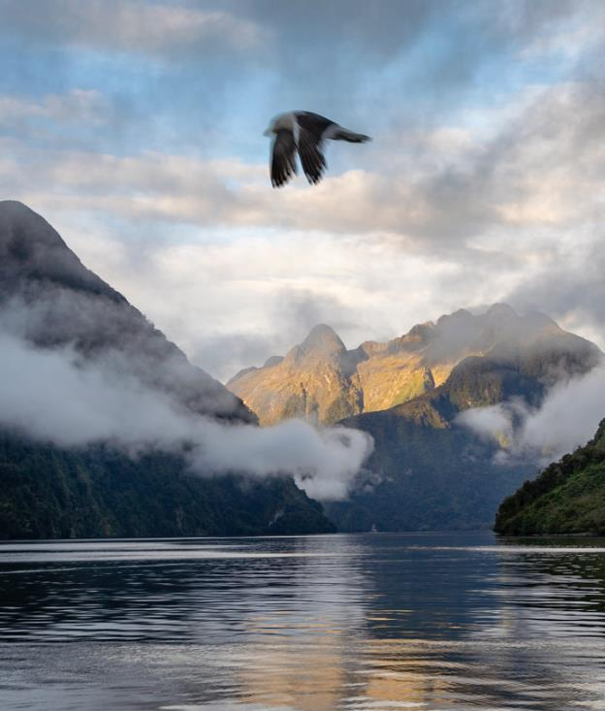
4.13 Monitoring Fiordland’s marine environment
The Fiordland Marine Guardians evolved from a collective that first came together in 1995 to safeguard Fiordland’s fisheries. Under legislation, they were formally established as advisors to maintain the health of Fiordland’s marine environment.
Together, they represent the interests of fishers, tourism, recreational users, marine science, conservation and the local community, including iwi.

Slide 30
5. Discussion
Please use the Q&A function to post your questions.

Slide 31
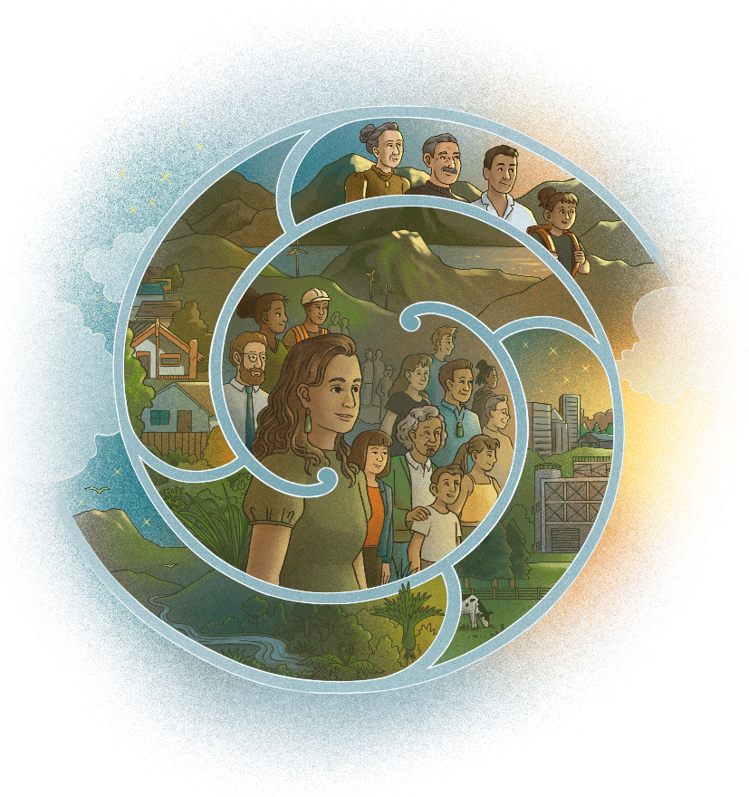
6. Conclusion
Just transitions enable communities to develop positive visions for change, transform unfair systems, draw on diverse strengths and worldviews, and come together to solve problems in ways that work better for everyone.
We wish you all the best on your just transition journey.

Slide 32
7. Where can you find the guide?
The guide is available online and can be downloaded for free from the following websites:
Ministry of Business, Innovation and Employment
https://mbie.govt.nz/just-transitions-guide
Motu Economic and Public Policy Research
https://www.motu.nz/our-research/environment-and-resources/just-transitions

